Slide 1
Pacemakers and Devices – Interactive Session
Sriram Rajagopal,
Southern Railway Hospital,
Perambur,Chennai

Slide 2
Pacemakers and Devices
Basics of Pacing and devices
Practical and day- to- day problems

Slide 3
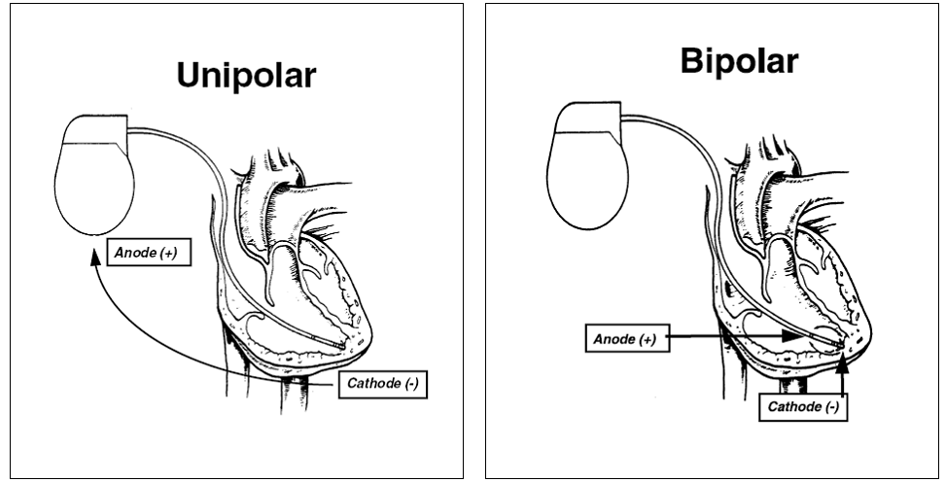
Pacemakers and Devices
What is “unipolar” pacing and “bipolar” pacing ?

Slide 4
Pacemakers and Devices
What is VVI pacing ?
What is DDD pacing ?
Modes of pacing – 3 and 5 letter codes
First letter – Chamber Paced -A , V or both (D) or none (O).
Second – Chamber Sensed- A , V or both (D) or none (O).
Third- Response to Sensing – inhibition (I) or triggering(T) or both (D)
Fourth - Rate adaptive pacing ( R )
Fifth - Multisite pacing (A),(V) or (D)

Slide 5
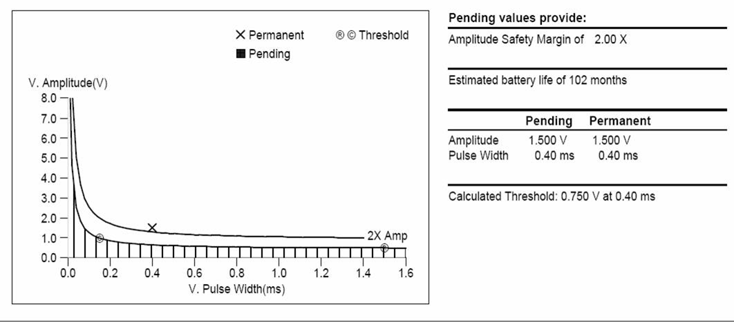
Pacemakers and Devices
What is pacing threshold ?
What is Strength-Duration Curve ?

Slide 6
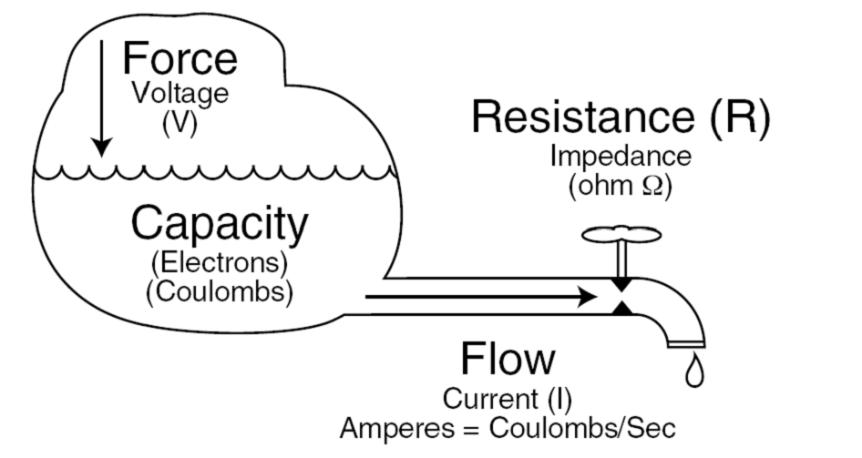
Pacemakers and Devices
Explain the concepts of Battery capacity, voltage,
Current flow and Resistance in pacing?

Slide 7
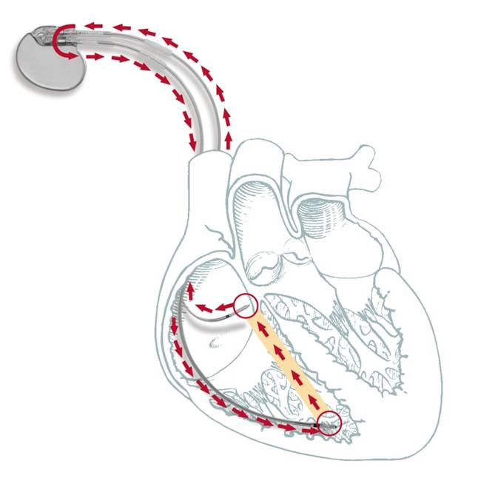
Pacemakers and Devices
What is Pacemaker Mediated tachycardia ?

Slide 8
Pacemakers and Devices
What is pacemaker syndrome ?
The term “pacemaker syndrome” refers to a combination of symptoms and signs related to adverse hemodynamic consequences of pacing (usually occurring in single chamber ventricular pacing).
Usually due to loss of AV synchrony

Slide 9
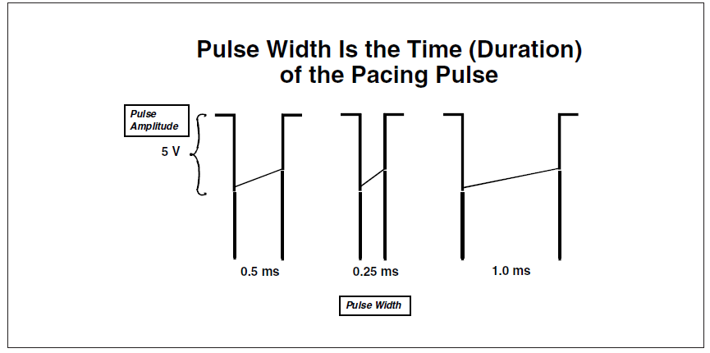
Pacemakers and Devices
How can one adjust “ Pacing Threshold” ?
Pacing threshold CANNOT be adjusted or programmed
Only the output of the pacemaker can be adjusted i.e Pulse amplitude and Pulse width

Slide 10
Pacemakers and Devices
What is meant by fusion ?
What is pseudo- fusion ?
Fusion is said to occur when both intrinsic and pacing induced depolarization contribute to the electrical activation of the chamber being paced.
In Pseudofusion the pacing stimulus does not in any way contribute to the depolarization of the chamber and hence the QRS morphology will be identical to an intrinsic beat, but will have a pacing stimulus artifact superimposed on it .

Slide 11
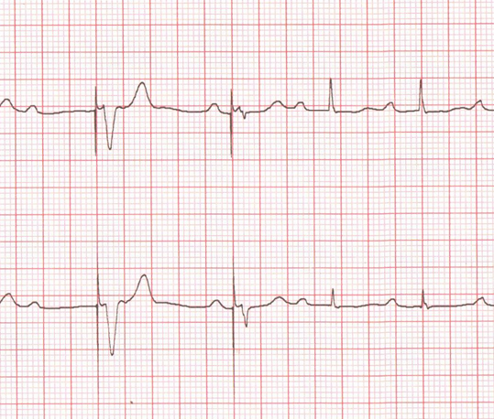
Pacemakers and Devices
Fusion : 1st QRS is paced and 3rd and 4th are intrinsic rhythm. Second is intermediate in morphology and is preceded by stimulus artefact

Slide 12
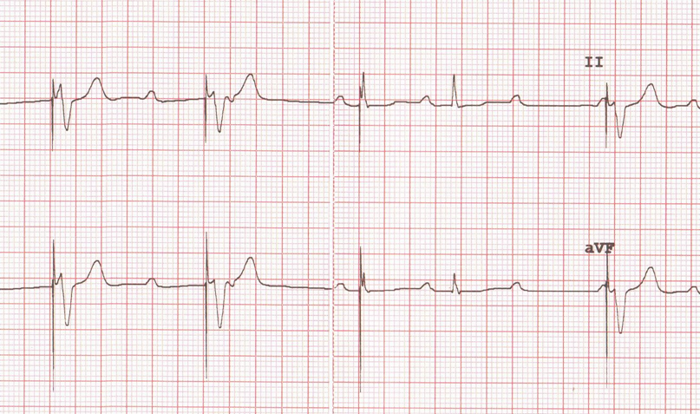
Pacemakers and Devices
1st, 2nd and 5th are paced QRS complexes, 4th is intrinsic QRS. 3rd is similar to intrinsic QRS ( repolarization also similar) but initial QRS deformed by stimulus artefact.
Pseudo-fusion.

Slide 13
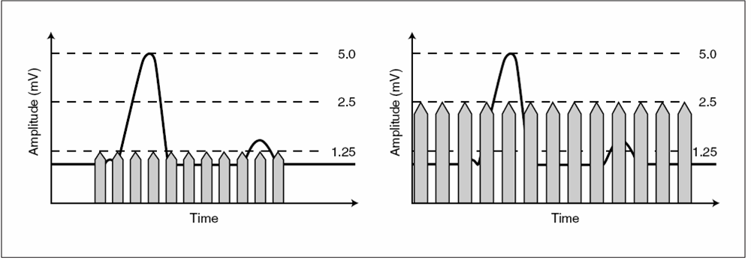
Pacemakers and Devices
If the sensitivity setting is changed from 2.5 to 5mV ,
Is the pacemaker “More sensitive” or “Less sensitive”? ?

Slide 14
Pacemakers and Devices
Recording from Holter in a patient with CHB who received
a single chamber pacemaker 2 years ago (VVIR 60/120)
What is the interpretation ?

Slide 15
Pacing and D evices
Interpret the tracing :
Hysteresis function allows a longer “escape interval” from a
Sensed event to the next paced event. Pacing interval is
Constant

Slide 16
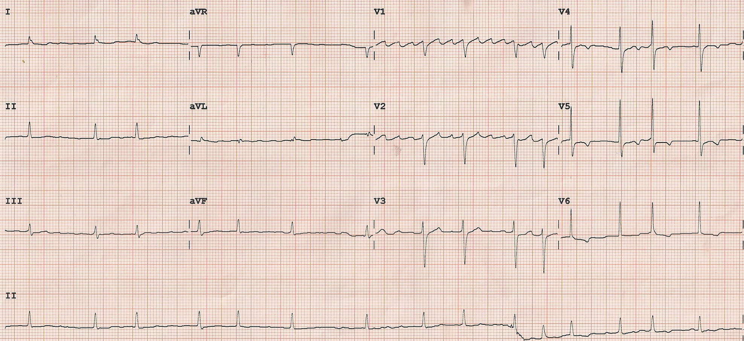
Pacemakers and Devices
60 year old lady. VVI pacing system implanted 12 years ago
for Symptomatic complete heart block. VVI 70/min. Hysteresis of
20bbpm. Recent onset giddiness with syncope.
ECG without magnet application
Notes:
Normal sensing, no pacing ( provided battery not completely dpleted).

Slide 17
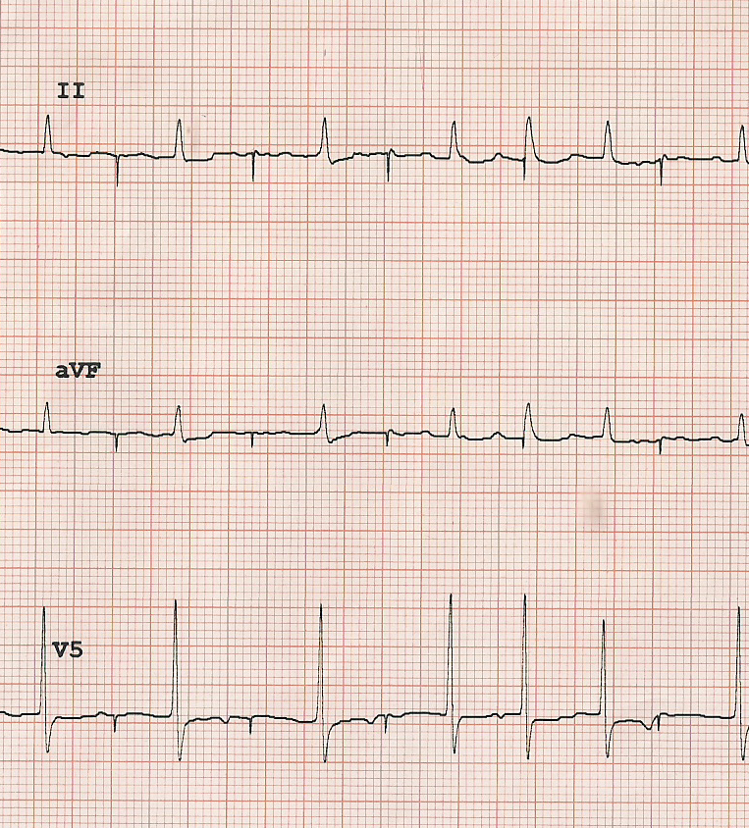
Pacemakers and Devices
Rhythm strip with magnet application

Slide 18
Pacemakers and Devices

Slide 19
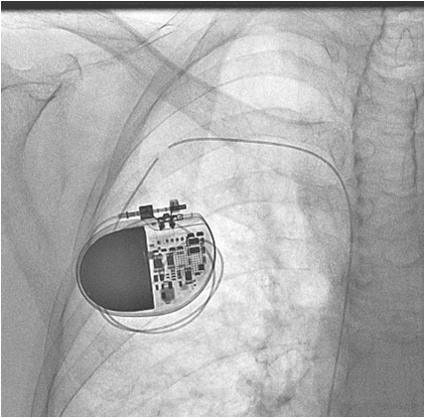
Pacemakers and Devices

Slide 20
Pacemakers and Devices
How do you identify the type and make of pacemaker in a
Patient with no records and a PG with depleted battery ?

Slide 21
Pacemakers and Devices
Name some recent advances in pacing technology .
Remote Monitoring
Leadless pacemaker
Battery- less pacemaker
Biological pacemaker

Slide 22
Pacemakers and Devices
What are the types of dys-synchrony to be addressed in CRT?

Slide 23
Elements of Cardiac Dyssynchrony
Inter-atrial
L Atrio-
ventricular
Intra-atrial
Synchrony
Intra-Left
ventricular
R Atrio-
ventricular
Inter-
ventricular
Cazeau, et al. PACE 2003; 26[Pt. II]: 137–143

Slide 24
Pacemakers and Devices
Unexplained Syncope, severe LV dysfunction and Idiopathic
Dilated Cardiomyopathy is
1. Class I indication for ICD
2. Class II a indication for ICD e
3. Class II b indication for ICD
4. Class III indication for ICD Amiodarone
Notes:
D

Slide 25
Pacemakers and Devices
What are inappropriate shocks?
What are the common causes ?

Slide 26
Pacemakers and Devices
Shocks delivered for “arrhythmias” other than intended ventricular arrhythmia
Sinus tachycardia, atrial fibrillation, SVTs , other electrical signals perceived as VT.

Slide 27
Pacemakers and Devices
Adaptive Dynamic Sensing is used in ICDs for
1. To identify VF
2. To differentiate AF from VF
3. To prevent T wave sensing
4. To sense Atrial Tachycardia
Notes:
C

Slide 28
Pacemakers and Devices
Which of the following is NOT a cause for arrhythmic storm
In a patient with an ICD
1. Deteriorating Heart failure
2. Elelctrolyte Imbalance
3. Myocardial Ischemia
4. Amiodarone
Notes:
D

Slide 29
Pacemakers and Devices
The Algorithm used to differentiate Atrial Fibrillation from
Ventricular Tachyacrdia in ICDs is
1. Interval Stability
2. Interval Rhythm Analysis
3. P-R logic
4. QRS duration analysis
Notes:
A

Slide 30
Thank you for your kind attention !

Slide 31
Pacemakers and Devices
Rhythm strip recorded from a patient with a VVI pacemaker.
Interpret the tracing .
Hysteresis – allows a longer “escape” interval after a sensed
Event till the next paced event .

Slide 32
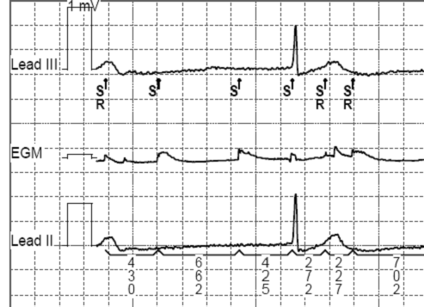
Pacemakers and Devices
What is Over- sensing ?
VVI
Below the top channel (surface ECG ) is the marker channel (showing what pacemaker is “doing”).Sensing is seen to occur even without any surface ECG activity.

